Slide 1


Truck-Drone Coordination in Last mile delivery
University Of Calcutta
Submitted by
Anubrata Naskar(Roll No.-C91/CSC/231005)
Soumili ray(Roll No.-C91/CSC/231025)
Tirtharoop Banerjee (Roll No.-C91/CSC/231031)
Under the guidance of
Prof. Sunirmal Khatua
M.sc semester-iv examination 2025
Department of computer science
And engineering
Date:10.06.2025

Slide 2

CONTENTS
1. Problem of Vehicle Routing
2. Why Need Hybrid Model
3. Deployment Benefits
4. Related Work
5. Objective of our work
6. Solution Approach
7. Result Analysis
8. Conclusion and Future Scope

Slide 3


01
Problem of Vehicle Routing
1

Slide 4


Problem of Vehicle Routing
1
E-commerce Growth
2
Traditional Delivery Issues
3
Non-Serviceable Areas
There are certain areas where trucks cannot go for delivery as the roads are not wide enough for the trucks to travel.
The rapid growth of e-commerce and rising customer expectations for faster deliveries have intensified challenges in last-mile logistics.
Traditional truck-based delivery systems face inefficiencies due to traffic congestion, fuel costs, and environmental concerns.
2

Slide 5

02
Why Need Hybrid Model
3

Slide 6

Organizational Gain
Consumer benefits
1
Reduced last-mile cost, Lower emissions of carbon footprint.
1
Quicker receipt of packages
2
Faster operations and parallel deliveries.
2
Service available in remote area
3
Contactless Delivery
5

Slide 7

03
Deployment Benefits
6

Slide 8

Drone Advantages
1
Drones offer fast, flexible, and efficient last-mile delivery, reducing labour costs and safety risks due to their ability to bypass road networks and operate autonomously.
Real-World Adoption
2
Companies like Amazon, UPS, and DHL have successfully tested and deployed drones, especially during the COVID-19 pandemic, with increasing support from regulatory bodies.
3
Hybrid System Solution
Combining trucks for long-distance hauling with drones for last-mile delivery offers a practical and scalable solution, balancing efficiency, flexibility, and operational feasibility.
6

Slide 9

04
Related Work
7

Slide 10



Vehicle Routing Problem
Drone Integration Studies
Two-Echelon Vehicle Routing
The Vehicle Routing Problem (VRP) has been a significant area of research with various algorithms developed over the decades.
Studies such as those by Murray and Chu (2015) and Luo et al. (2017) have integrated drone capabilities into classical routing problems.
Based on the paper “The Two-Echelon Vehicle Routing Problem with Drones in last my delivery” 2EVRPD model has been introduced to optimize last-mile delivery by synchronizing truck and drone operations.
7

Slide 11

05
Objective of our work
8

Slide 12

1
Incorporating dynamics battery consumption.
Exploring strategic decisions like vehicle-drone assignment, dynamic drone launching and computational efficiency.
2
Time synchronization between truck and drone.
3
9

Slide 13
06
Solution Approach
10

Slide 14


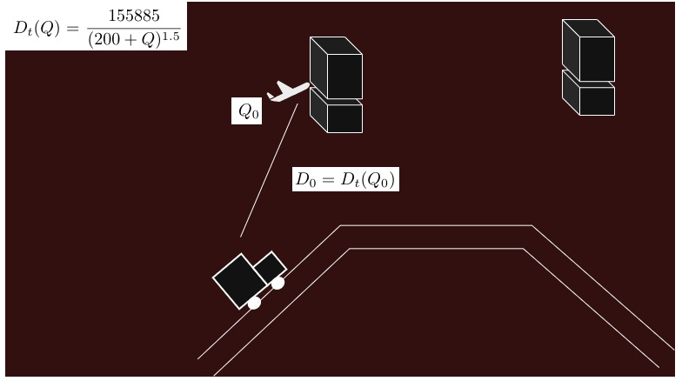
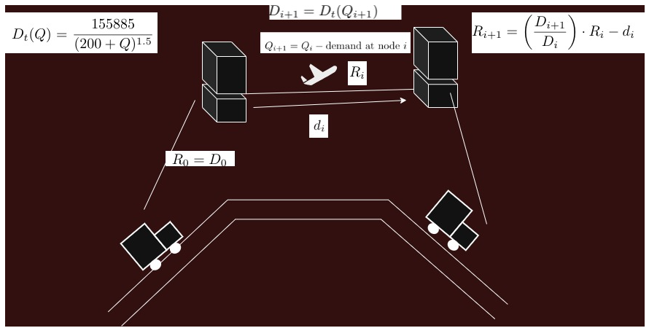
Dynamic Battery Recalculation Model
• The drone’s maximum range depends on its current payload, dynamically adjusting the remaining battery based on this changing payload.
Fig 1
Fig 2
Modified K-Means + ILP
• Demand-weighted K-Means clustering creates balanced initial truck routes.
• ILP optimizes drone takeoff/landing points, ensuring synchronization and battery constraints.
K-Medoids + Heuristic Approach
• Robustness to irregular customer distributions.
• High-quality solutions within polynomial time, allowing for dynamic changes in the delivery environment.
11

Slide 15
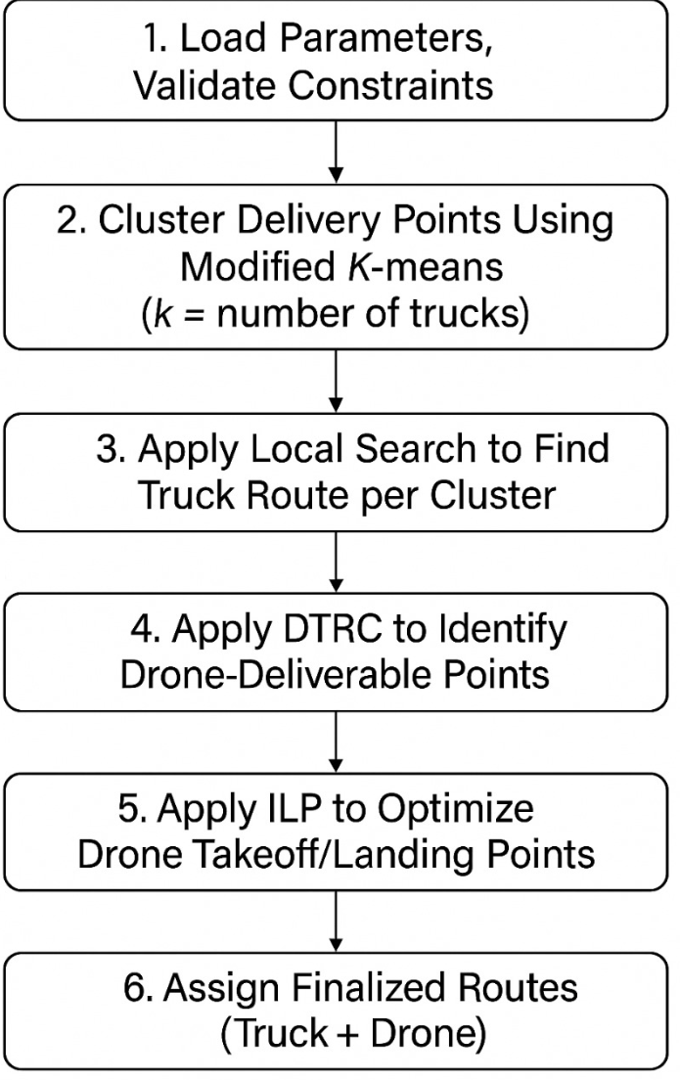
Modified K-Means + ILP
Algorithm workflow
12

Slide 16
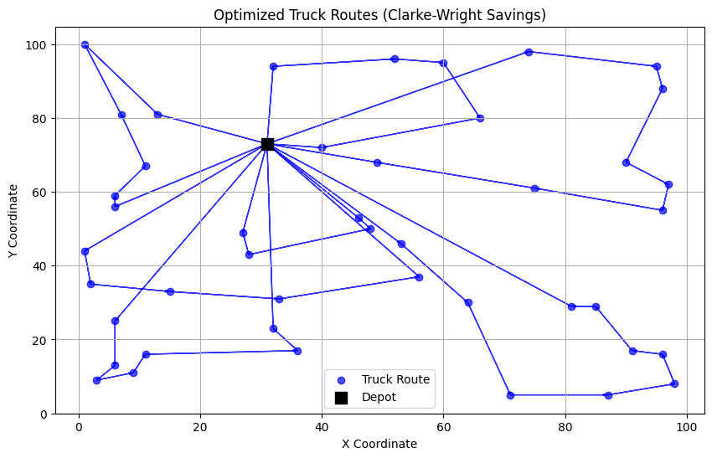
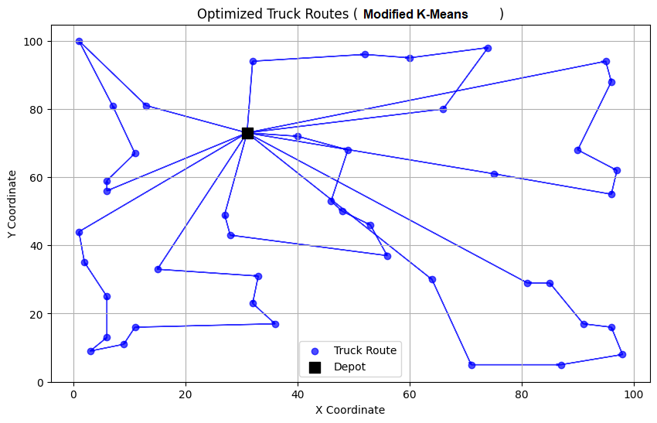
Modified K-Means
Modified K-means
• Why required to use Modified K-Means than use savings algorithm?
Fig 3
Fig 4
13
A-n45-k6.vrp

Slide 17
DTRC
How DTRC help here to find drone delivery point?
Select an available drone from the set of drones.
If no drone is available, skip to truck-only delivery.
Choose the best node for the drone to deliver (based on minimum cost / distance).
Check constraints: If the drone’s load and battery are sufficient, assign the delivery.
Update the route and drone status, and add the delivery point to Landing.
If delivery is done, return the drone to the truck and mark it available again.
Repeat until all nodes are served.
14

Slide 18
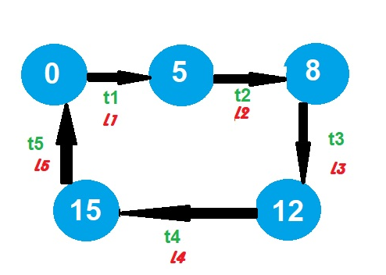
How to find drone takeoff and landing point?
Fig 5
16

Slide 19
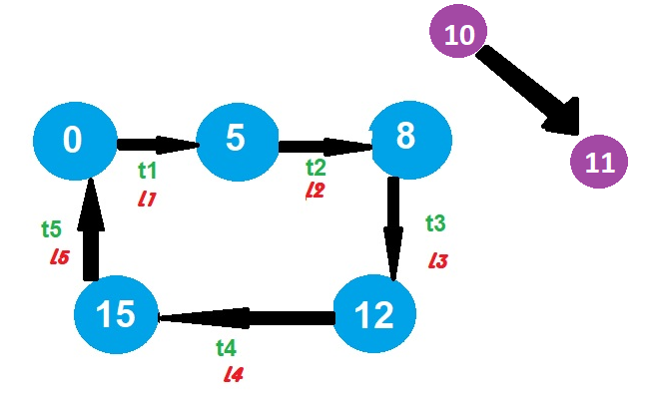
How to find drone takeoff and landing point?
Fig 6
17

Slide 20
Follows,
Tn <= Ln
Dist(Tn,10)+Dist(10,11)+Dist(11,Ln) <= Battery_m(w)
How to find drone takeoff and landing point?
Find Distance Each Segment,
Phase 1: Segment Distance Analysis & Selection
Step 1: Calculate All Segment Distances
Compute distance matrix between takeoff segments
(T1, T2, T3, T4) and landing segments (L1, L2, L3, L4)
Calculate: D(T1,L1), D(T1,L2), D(T1,L3), D(T1,L4),D(T2,L2), D(T2,L3), D(T2,L4), D(T3,L3), D(T3,L4), D(T4,L4)
Step 2: Sort and Select Optimal Segment Pair Sort all distances in ascending order
Select the shortest distance pair: d[5, T2, L3]
This gives us the takeoff segment T2 and landing segment L3 for optimization
18

Slide 21
How to find drone takeoff and landing point?
Phase 2: Scipy.optimize.minimize - Continuous Optimization
Step 3: Parameter Space Definition
T2 segment: Parameterize from last coordinate to first coordinate (reverse direction)
L3 segment: Parameterize from first coordinate to last coordinate (forwarddirection)Search space: T2 ∈ [0,1], L3 ∈ [0,1]
Step 4: Iterative Optimization ProcessIterations: 50-100 per combinationTotal
Function Evaluations: 1250-2500
Objective Function: Minimize synchronization score
Sample Optimization Progress:
Try 1: T2=0.2, L3=0.8 → Score: 25.3
Try2: T2=0.23, L3=0.79 → Score: 25.1 ✓ (Better!)
Try 3: T2=0.26, L3=0.78 → Score: 25.4 ❌ (Worse)
...Try 87: T2=0.314, L3=0.703 → Score: 18.2 ✓ (Best so far!)
Step 5: Segment DiscretizationDiscretize
T2 segment around optimal continuous solutionDiscretize
L3 segment around optimal continuous solutionCreate
discrete point sets: Xi ∈ T2_discretized, Yi ∈ L3_discretized
19

Slide 22
How to find drone takeoff and landing point?
Phase 3: PuLP Linear Integer Programming
Step 6: Binary Variable Creation : Create binary variables Zxy for each point pair combination Zxy = 1 if point pair (Xi, Yi) is selected, 0 otherwise
Step 7: Distance and Time Calculations For each point pair (Xi, Yi):
d1 = D(Xi, node_10) - Distance from takeoff point to intermediate node
d2 = D(node_10, node_11) - Constant distance between fixed nodes
d3 = D(node_11, Yi) - Distance from intermediate node to landing point
d4 = D(Xi, Yi) - Direct distance between takeoff and landing points
Step 8: Time Synchronization Constraints
Drone Time Calculation:
Tdrone = (d1 + d2 + d3) / 1.5
Truck Time Calculation:
Ttruck = d4 / 1.0
Synchronization Constraint: ∑(x,y) Zxy · (Tdrone - Ttruck) = 0
Step 9: Linear Programming Formulation
Objective Function: minimize ∑(x,y) Zxy · Tdrone
20

Slide 23
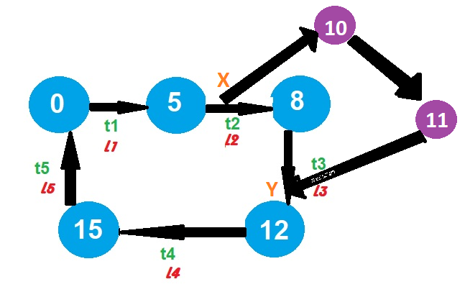
How to find drone takeoff and landing point?
Fig 7
21

Slide 24
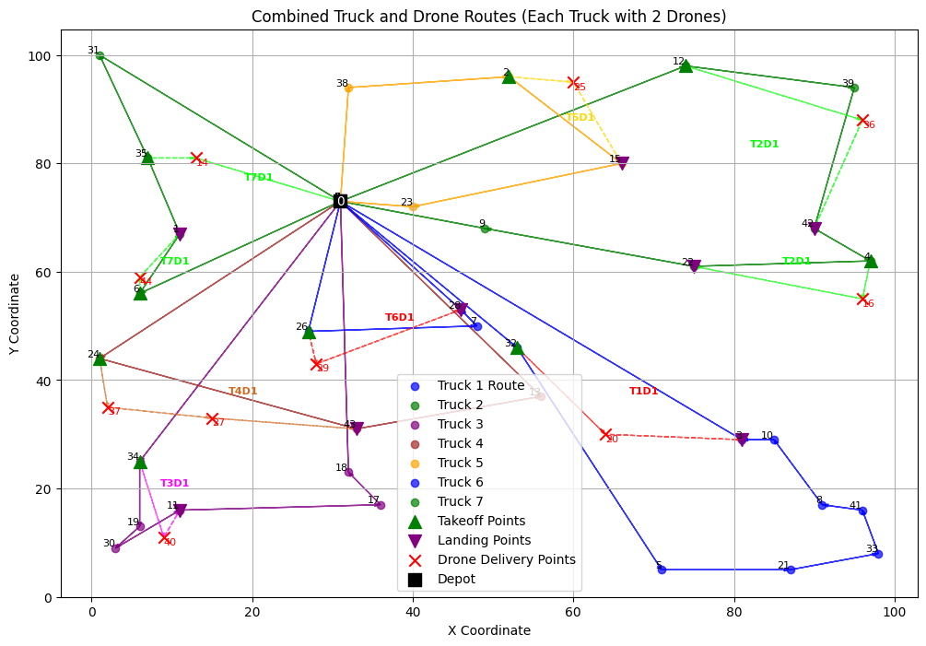
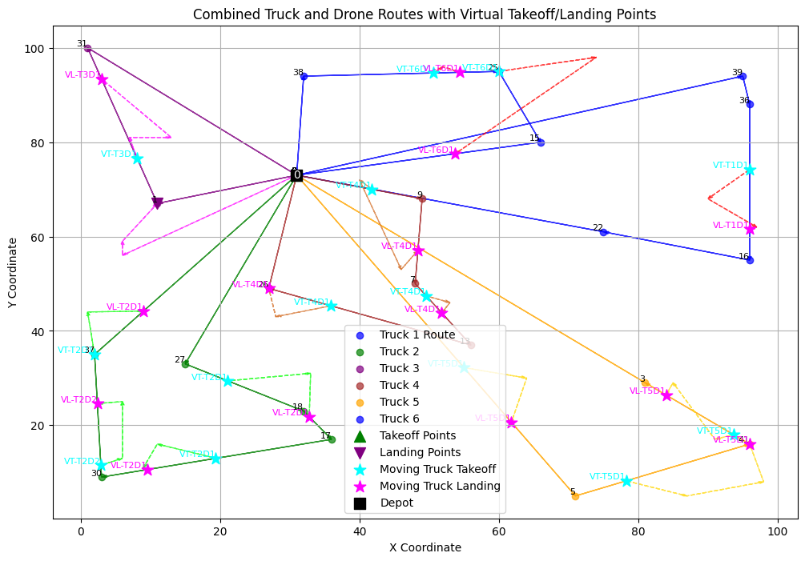
Solution :
Fig 8
Fig 9
A-n45-k6.vrp
22

Slide 25
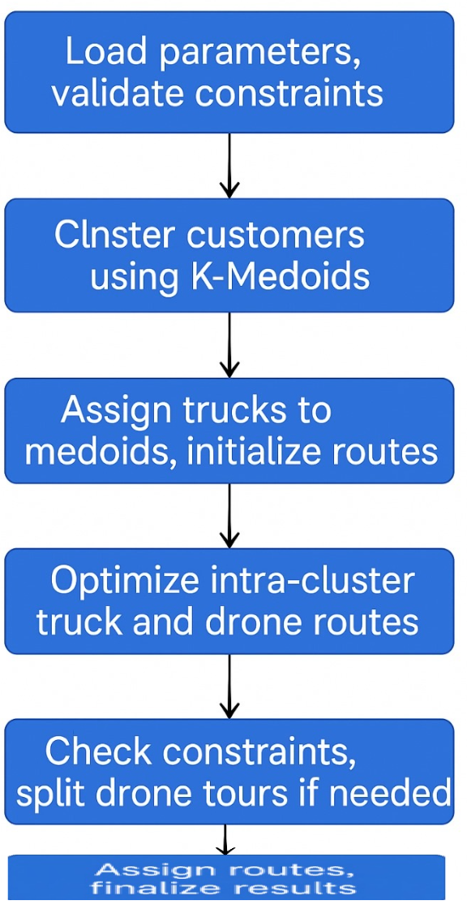
Kmedoid + Heuristic
Algorithm workflow
23

Slide 26
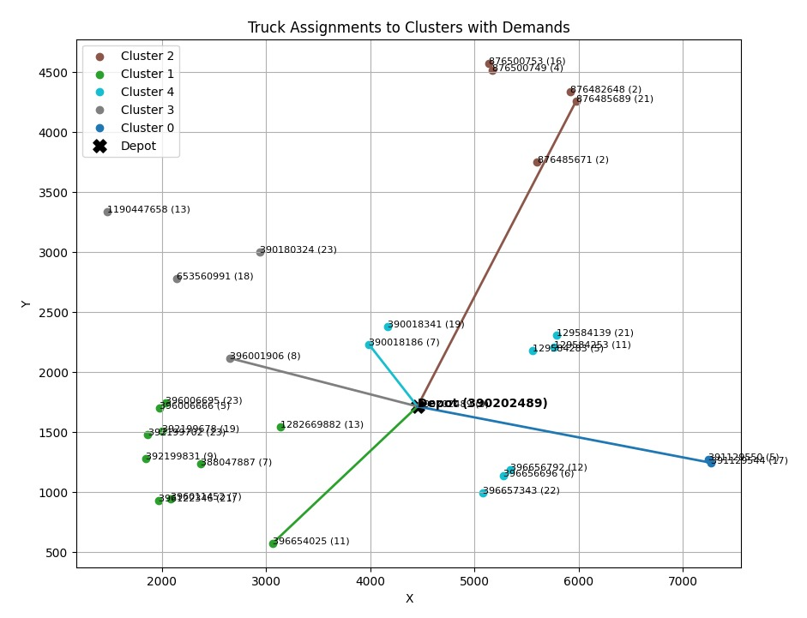
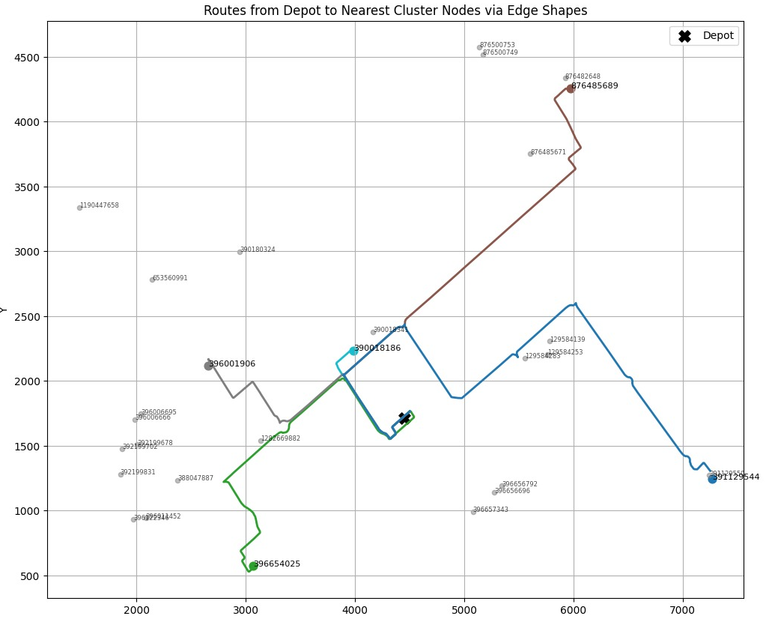
1
Initialize clustering using Kmedoid
(using pyclustering.cluster.kmedoids )
Why Choose K-Medoids ?
K-Medoids clustering is chosen because it produces representative cluster centers that are actual customer locations. This ensures practical and interpretable start and endpoints for truck routes. Its robustness to outliers and adaptability to irregular spatial distributions make it more reliable .
Assign trucks to each cluster and initialize routes
2
Fig 10
24
Fig 11

Slide 27
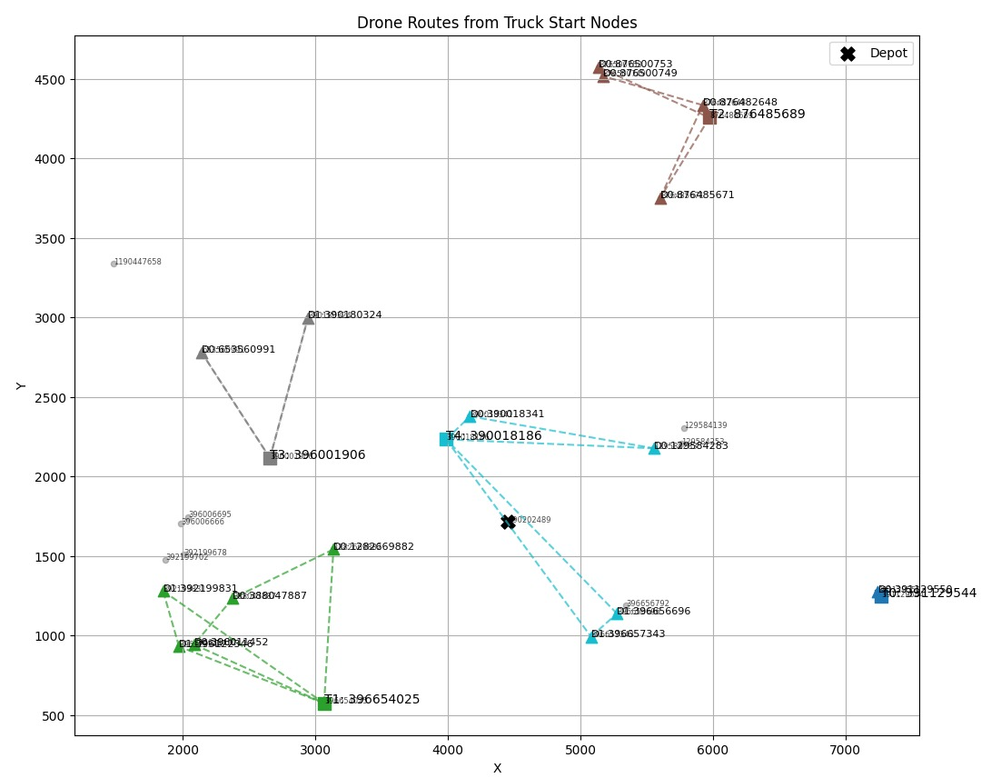
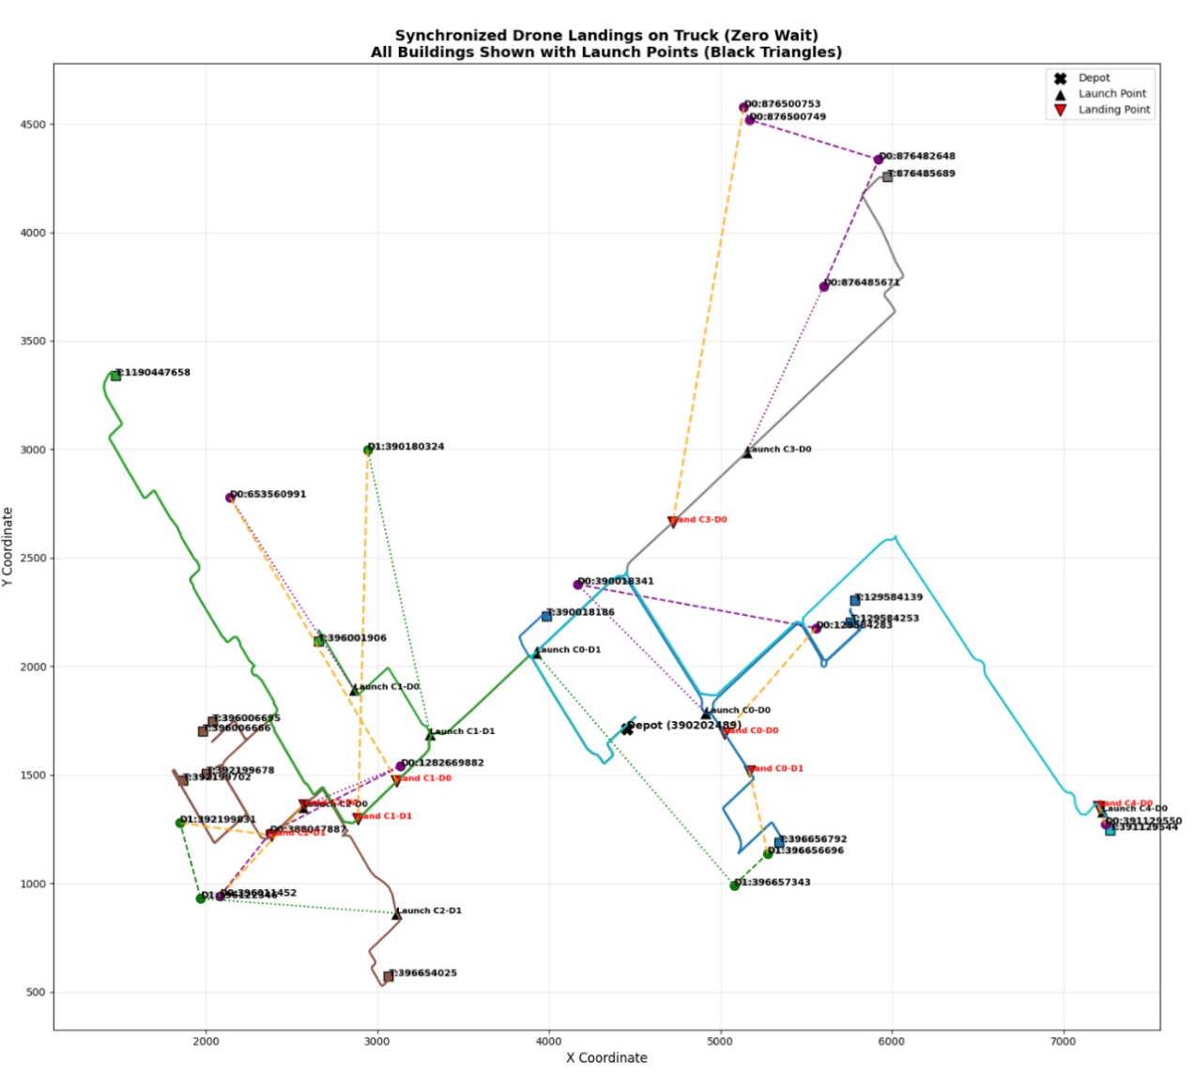
3
Finding drone routes within the clusters
After applying launching and landing algorithm final result
4
Fig 12
25
Fig 13

Slide 28
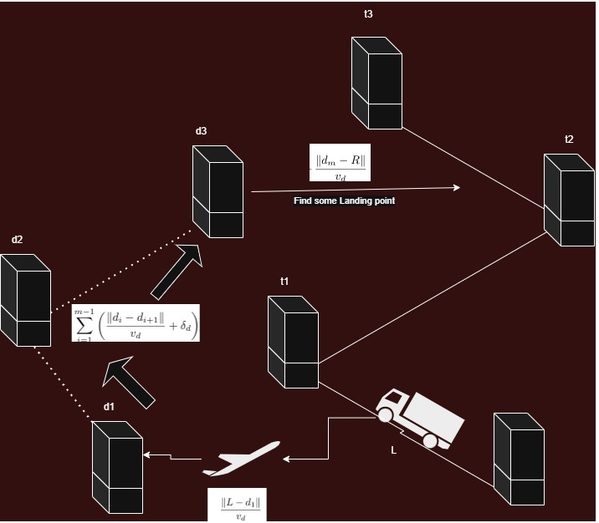
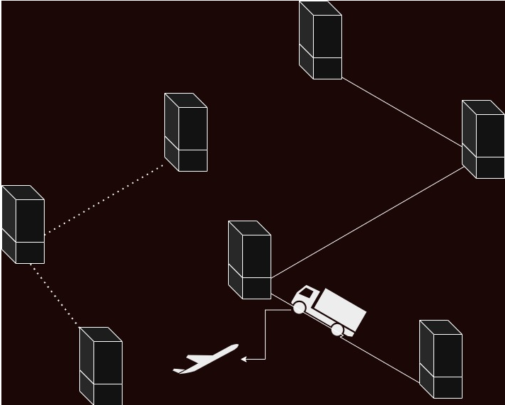
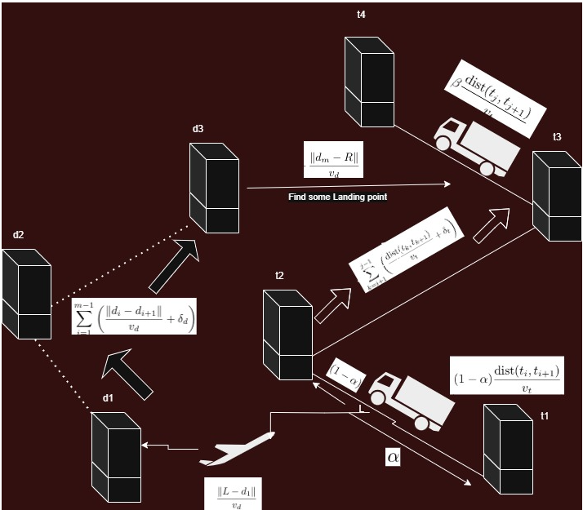
Mathematical formulation for Time Synchronization using Heuristic approach:
Fig 14: Truck and drone route visualisation
Fig 15: Drone Flight Time Formulation
Fig 16: Truck Path Formulation
26

Slide 29
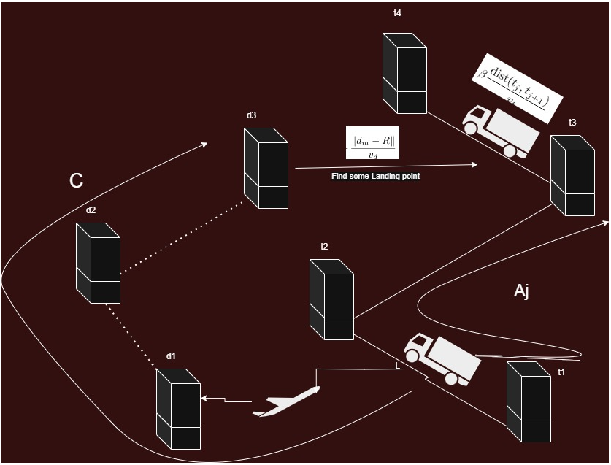
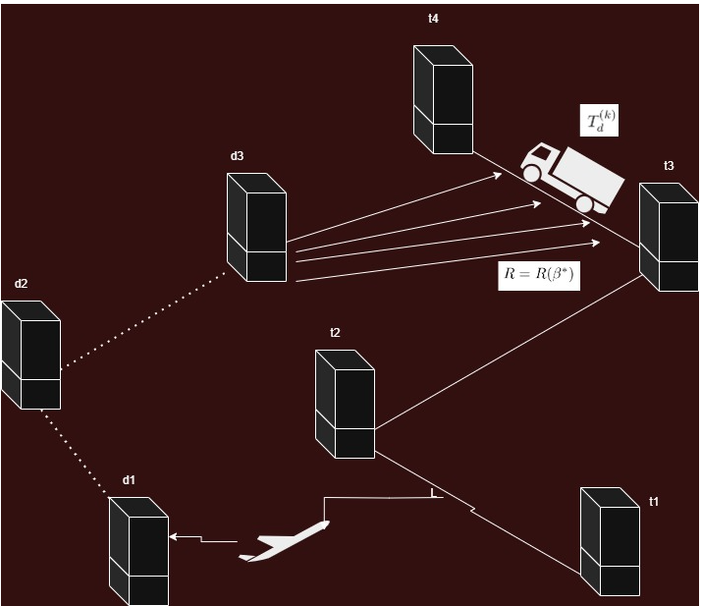
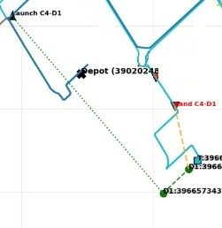
Fig 17: Objective Formulation
Fig 18: Heuristic approach of finding landing point
Why Heuristic approach is chosen?
Heuristics provide high quality solutions within polynomial time, allow incremental integration of domain-specific rules (e.g. drone range and payload limitations), and are more adaptable to dynamic changes in the delivery environment.
27

Slide 30

07
Result Analysis
28

Slide 31
Cost Comparison (Euclidean Distance)
Instance | DTRC Cost | Modified Kmean + ILP | Kmedoid + HEURISTIC
A-n45-k6.vrp | 1078.43 | 911.64 | 797.44
B-n34-k5.vrp | 860.23 | 646.30 | 798.19
P-n60-k10.vrp | 886.28 | 796.90 | 725.53
28

Slide 32
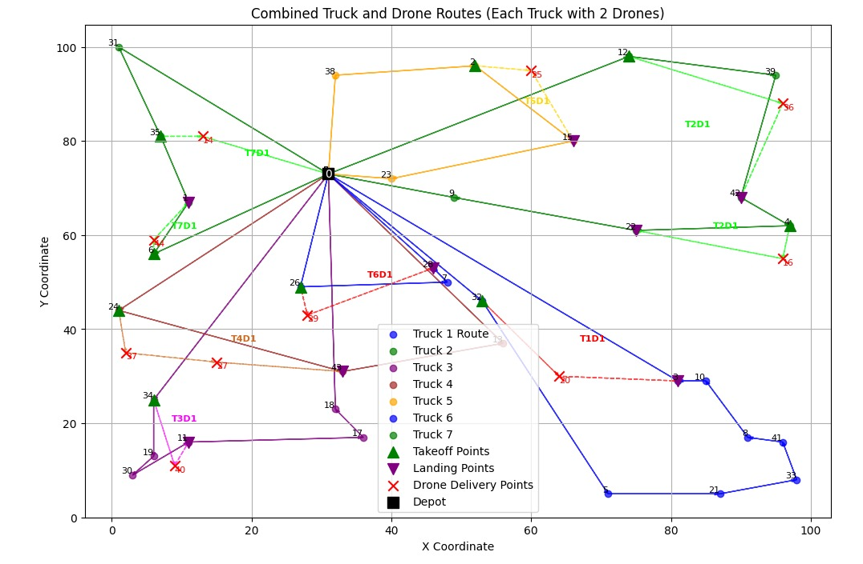
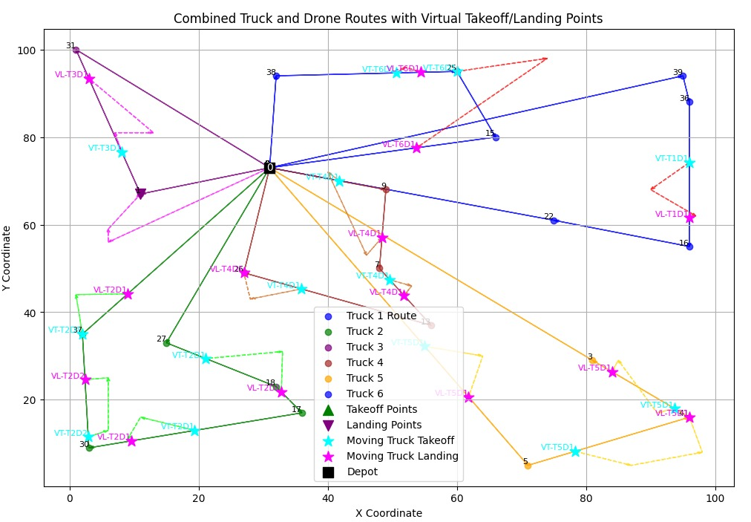
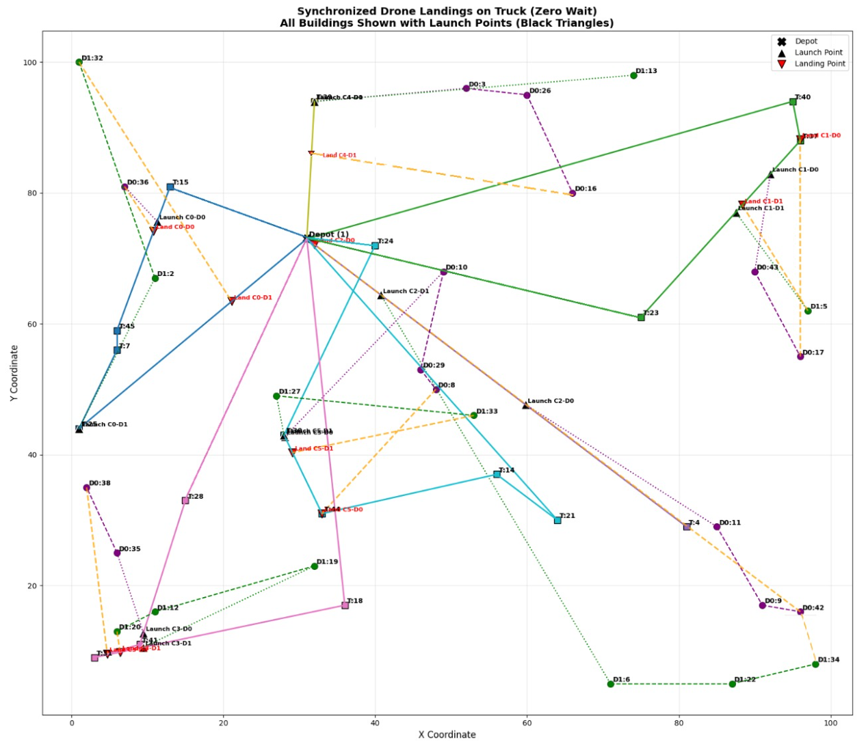
Route Visualisation(A-n45-k6.vrp)
Fig 19 :DTRC
Fig 20: Modified KMeans + ILP
Fig 21: Kmedoid + Heuristic
29

Slide 33
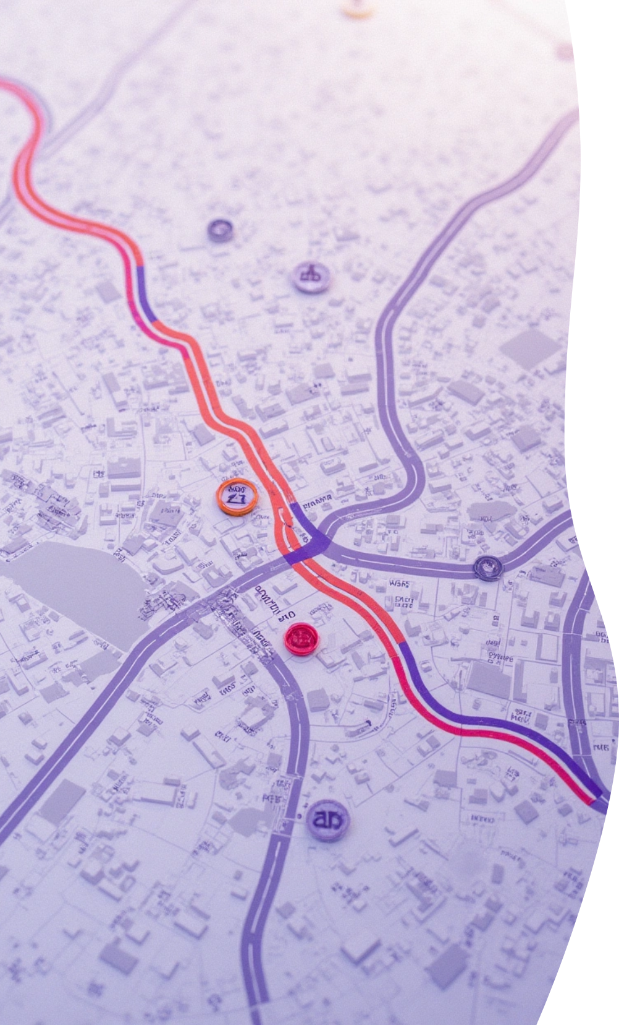
By Road visualization (Chandigarh)
30

Slide 34
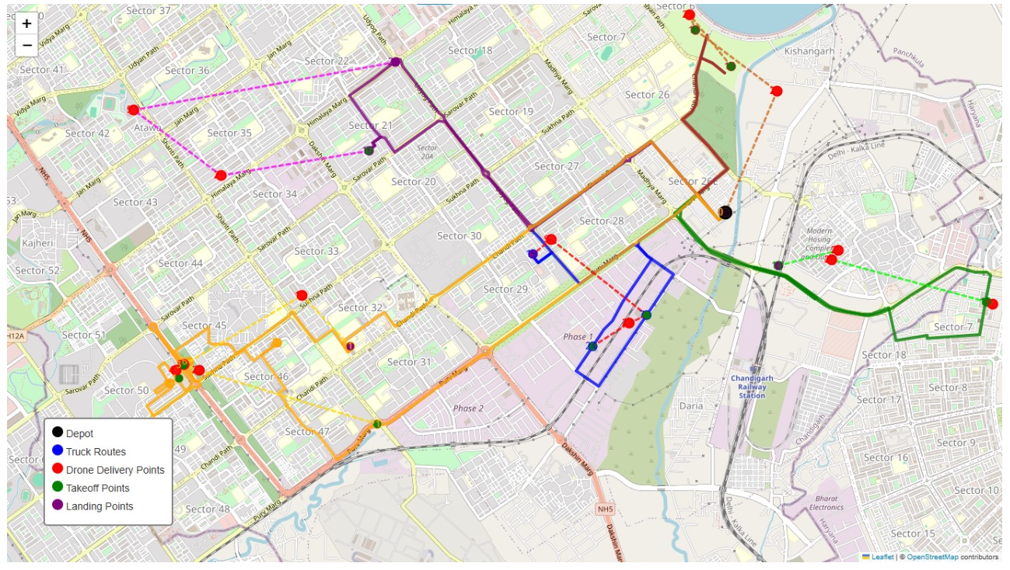
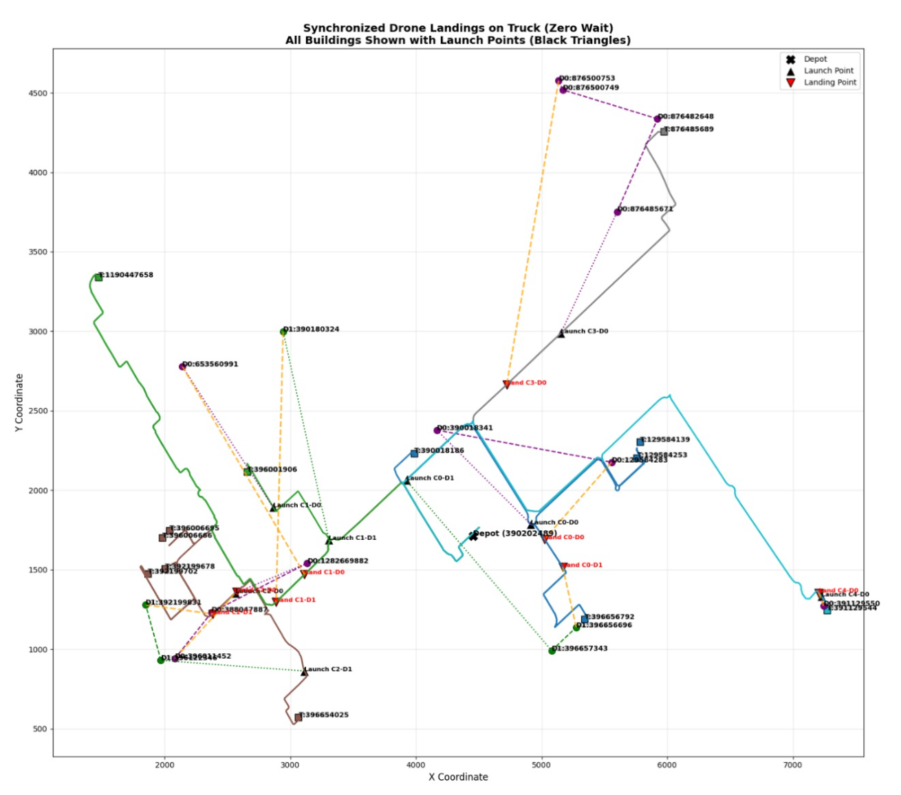
Fig 22: Chandigarh route map(google API)
Fig 23: Chandigarh route map(SUMO)
31

Slide 35
08
Conclusion and Future Scope
32

Slide 36


Closing remarks towards long term vision
The proposed framework optimizes last-mile logistics through coordinated truck-drone delivery, reducing operational costs and enhancing delivery efficiency.
Future research can extend the model to handle multiple demands from the same customer node and explore dynamic drone landing strategies to increase system adaptability.
33

Slide 37
References
• A.Zhan, X.Li, J. Ma, Q.Meng. Multi-objective optimization for drone-assisted delivery considering customer satisfaction and energy consumption. Annals of Operations Research, 2023. https://link.springer.com/article/10.1007/s10479-023-05418-y
• H. Xu, Y. Li, M. Du, H. Wang. Optimizing Drone Delivery with Energy Consumption and Time Windows: A MILP Approach. Drones, 8(1), 27, 2024. https://www.mdpi.com/2504-446X/8/1/27
• R. D’Andrea. Guest editorial can drones deliver? Artificial Intelligence, Volume 287, 2020. https://www.sciencedirect.com/science/article/abs/pii/S0957417421002955
• A. Allegretti, F. Dell’Amico, A. Faloppa, A. Hadjicharalambous. A MILP formulation for the capacitated vehicle routing problem with drones. Politecnico di Milano Repository (preprint). https://re.public.polimi.it/bitstream/11311/1228778/4/Manuscriptiris.pdf
• T. Poikonen, S. Golden, B. P. Golden. The vehicle routing problem with drones: Extended models and connections. European Journal of Operational Research, Volume 274, Issue 2, 2019. https://www.sciencedirect.com/science/article/abs/pii/S0925527319300106
• H. Y. Jeong, B. D. Song, S. Lee. Truck-drone hybrid delivery routing: Payload-energy dependency and NoFly zones. Transportation Research Part C: Emerging Technologies, Volume 102, 2019. https://doi.org/10.1016/j.trc.2019.02.022
• P. Kitjacharoenchai, B.-C. Min, S. Lee. Two echelon vehicle routing problem with drones in last mile delivery. International Journal of Production Economics, Volume 225, 2020. https://doi.org/10.1016/j.ijpe.2019.107598
• laporte2009 G. Laporte, “Fifty Years of Vehicle Routing,” Transportation Science, vol. 43, no. 4, pp. 408–416, 2009. https://doi.org/10.1287/trsc.1090.0301
34

Slide 38

Thank You

